Slide 1
MGT388 Finance for Engineers
Lecture 7:
Pricing Decisions

Slide 2
Lecture Outline
Economic Theory
Cost plus pricing: Absorption costing or Variable costing
Target pricing
Life Cycle Analysis

Slide 3
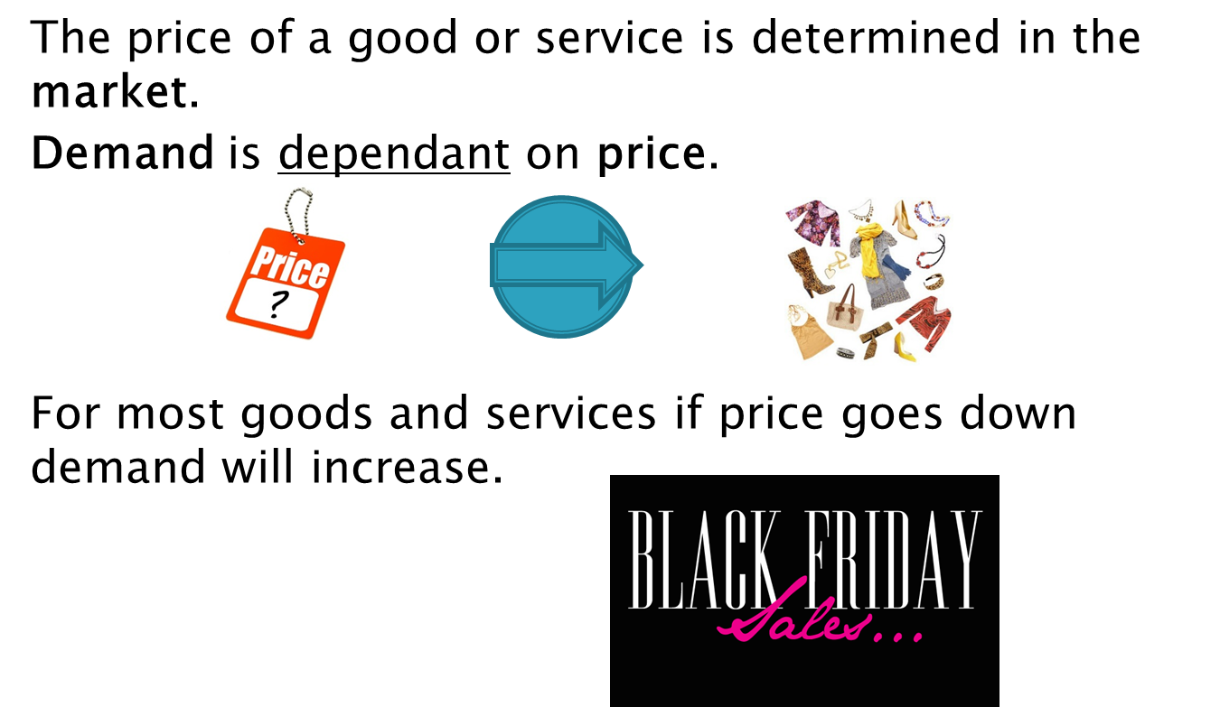
Economic Theory

Slide 4
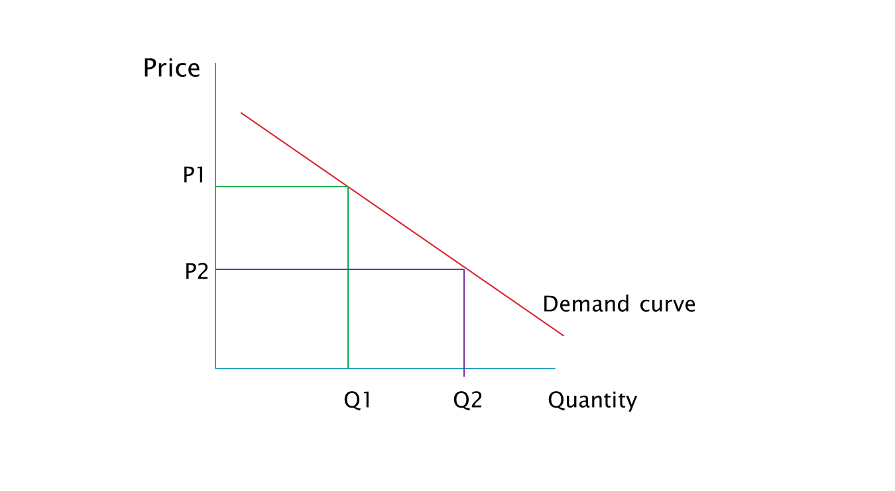
Demand curve
Possible
price/quantity combinations
A
B

Slide 5

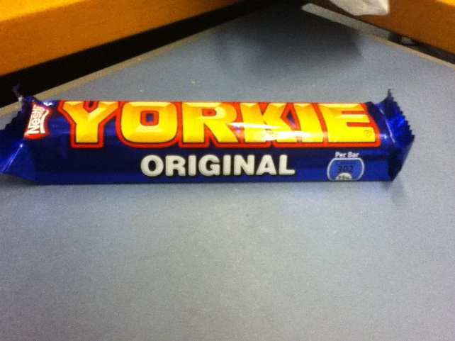
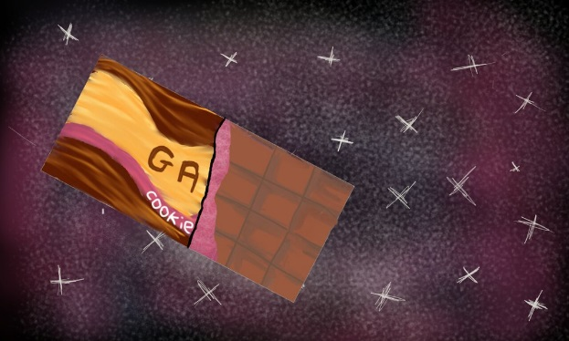
Elasticity弹性 of demand
The shape of the demand curve depends on elasticity.
If a change in price leads to a more than proportionate change in quantity demanded, then demand is said to be elastic.
如果价格的变化导致需求量的变化超过比例，那么需求就被称为弹性的。
Products that can swapped/substituted for a similar product have elastic demand.
可以替代/替代类似产品的产品具有弹性需求。

Slide 6
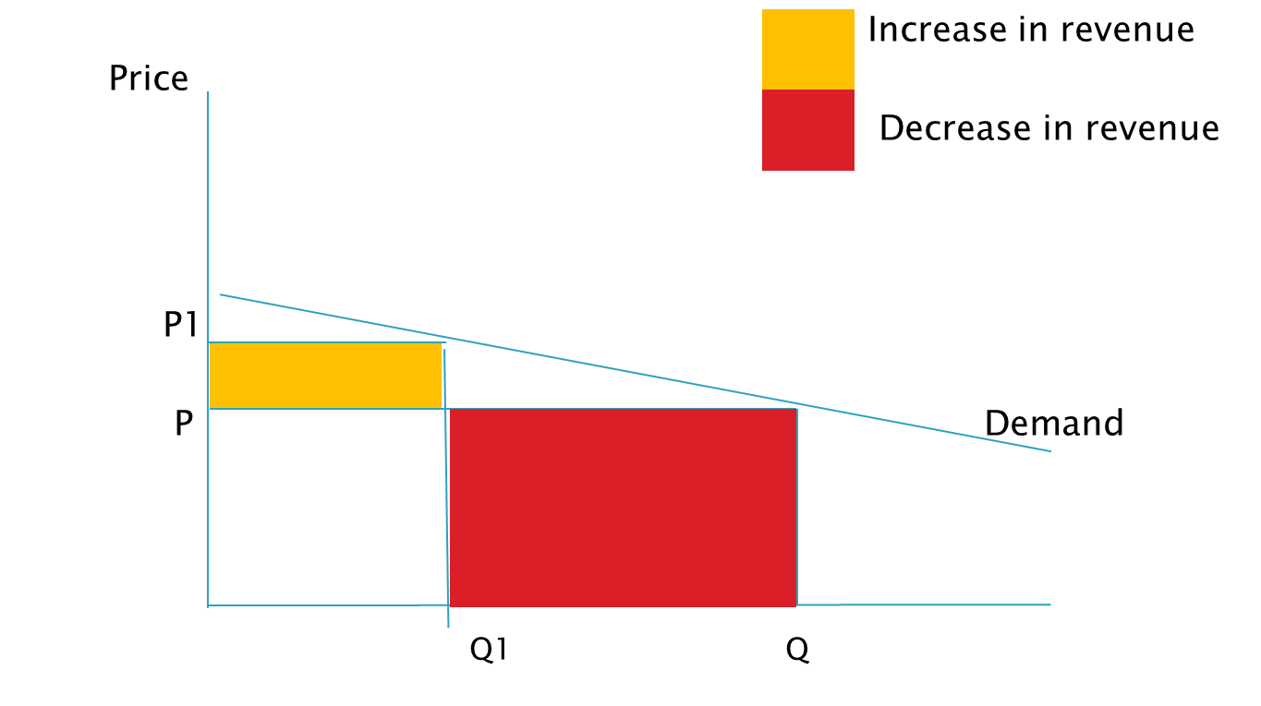
Elasticity of demand
Elastic demand

Slide 7

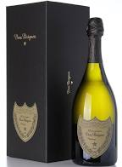
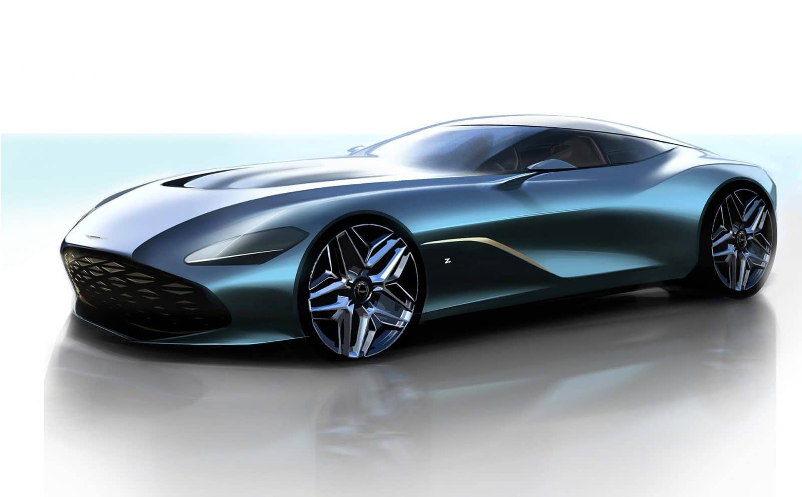
Elasticity of demand
If a change in price leads to a less than proportionate change in quantity demanded then demand is said to be inelastic.
如果价格的变化导致需求量的变化不成比例，那么需求就被称为无弹性的。
Product that have inelastic demand are often premium or luxury products.
需求缺乏弹性的产品通常是高端或奢侈品。

Slide 8
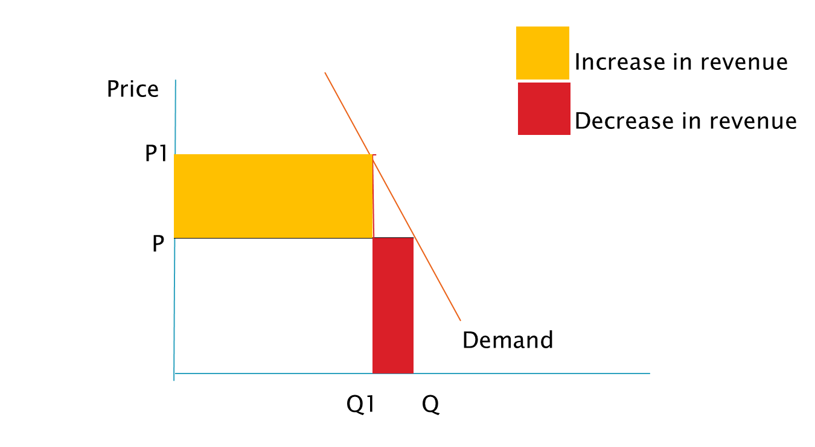
Elasticity of demand
Inelastic demand

Slide 9
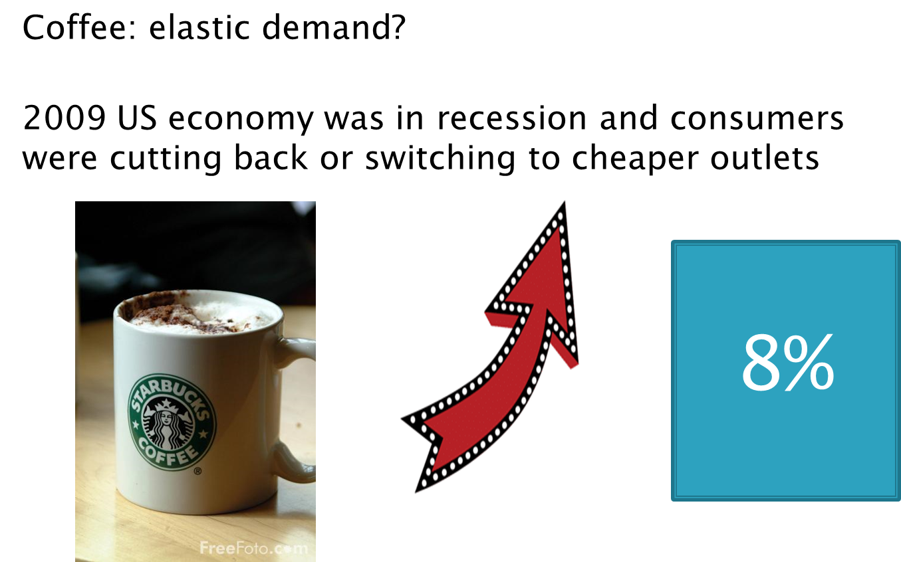
Case Study: Starbucks

Slide 10
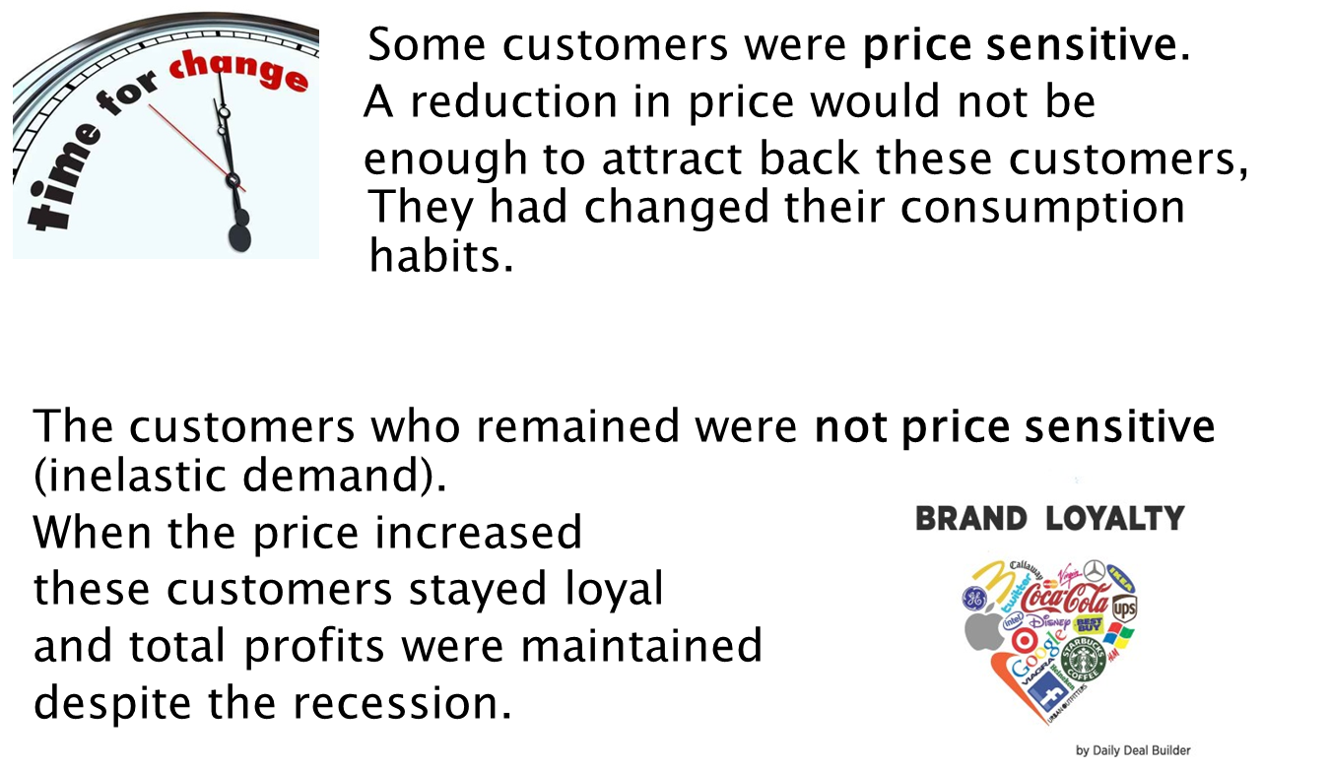
Case Study: Starbucks

Slide 11
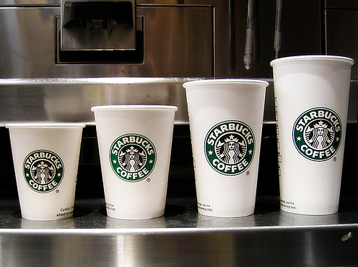
Case Study: Starbucks
Starbucks continued with value-based pricing.
It increased profits by increasing prices on selected products – e.g. small coffees.
It informed customers of limited price increase - due to labour and commodity costs.
Inelastic demand curve: few customers went elsewhere, some switched product to large which had better margins.
Profitability improved.

Slide 12
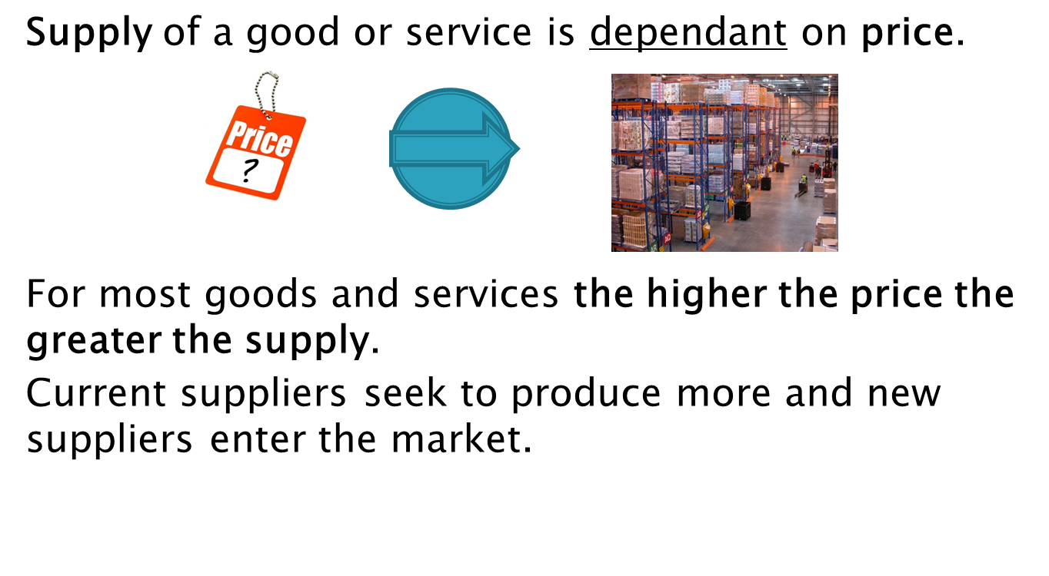
Economic Theory

Slide 13
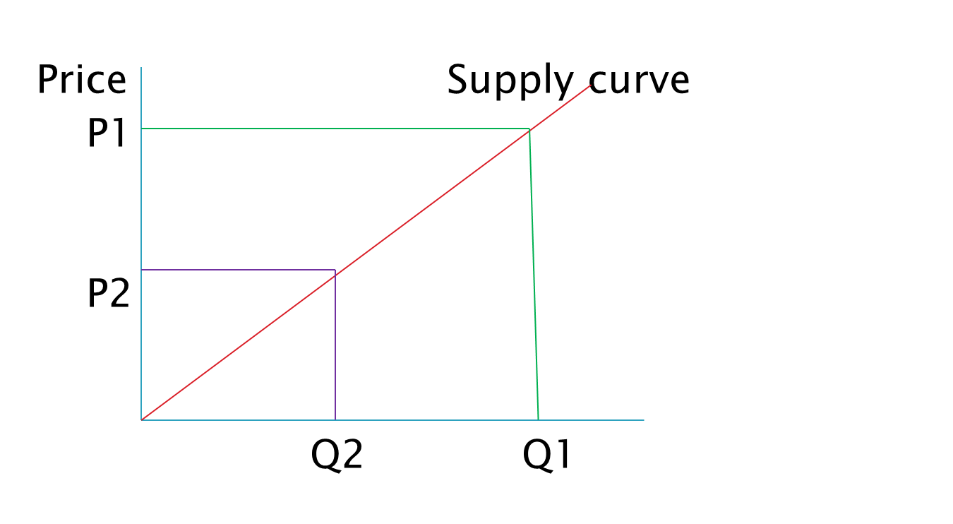
Supply curve

Slide 14
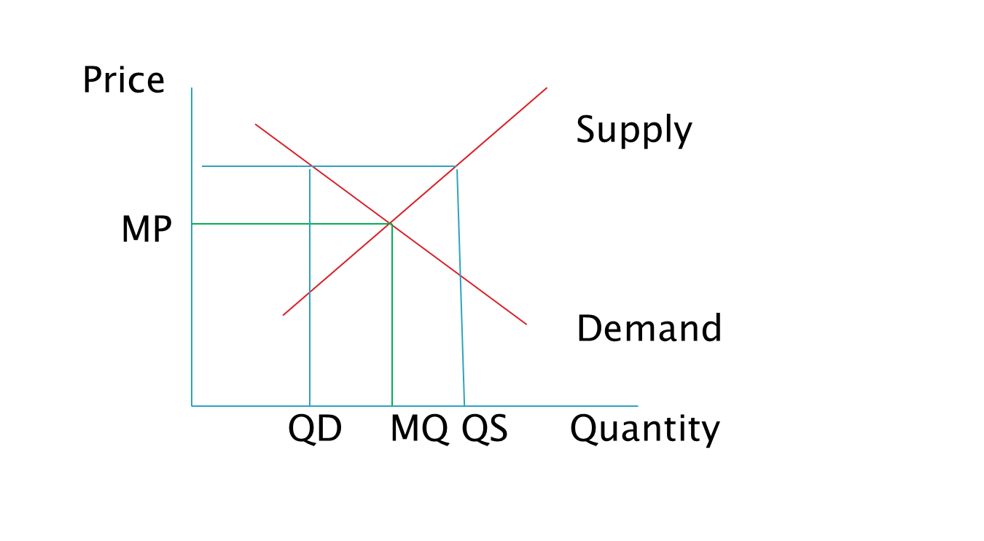
Market price

Slide 15
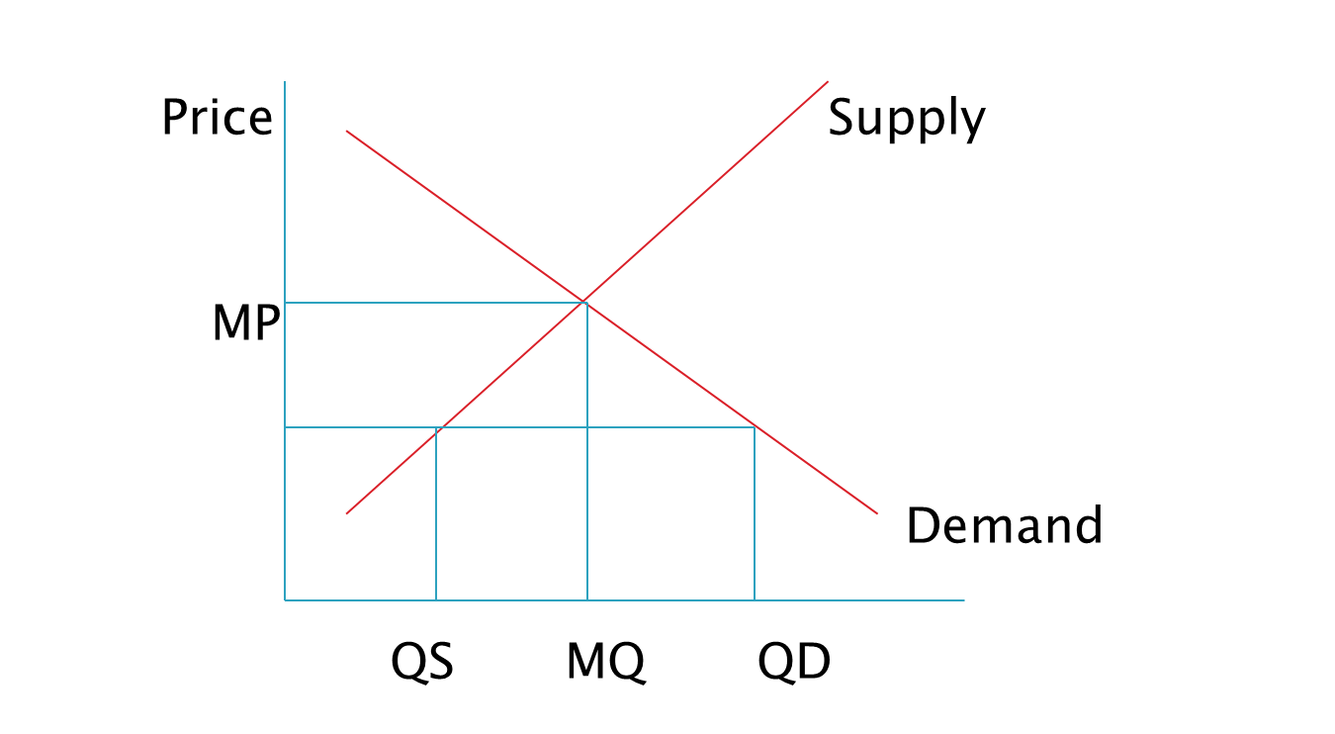
Market price

Slide 16
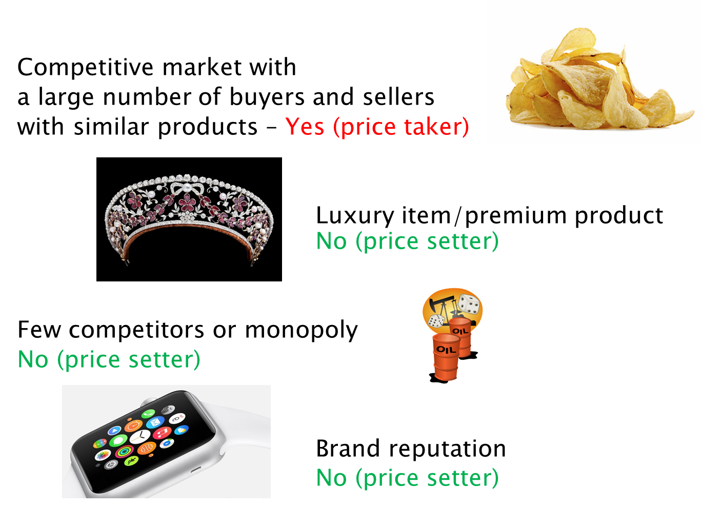
Do you have to accept market price?

Slide 17
Cost Based Pricing - Absorption Costing (Cost-Plus Pricing)
In an environment with little or no competition or where products are unique or clearly distinguishable from competitor goods, a company may have to set its own price (price setter), as a function of product cost.
In determining the proper mark-up, a company must consider:
Competitive and market conditions
Covering non-manufacturing overheads
The desired return.
Cost + Mark-up = Selling Price

Slide 18
Cost Based Pricing - Absorption Costing (Cost-Plus Pricing)
Illustration: Art project plc is in the process of setting a selling price on its new design lamp. The per unit variable cost estimates for the new lamp are as follows:
 | Per Unit
Direct materials | £46
Direct labor | 34
Variable manufacturing overhead | 24
Variable selling and administrative expenses | 16
Variable cost per unit | £120

Slide 19
Cost Based Pricing - Absorption Costing (Cost-Plus Pricing)
In addition, Art Project has the following fixed costs per unit at a budgeted sales volume of 10,000 units:
Per Unit
Fixed manufacturing overhead (£700,000) £70
Fixed selling and administrative expenses (£600,000) 60
Fixed cost per unit (at 10,000 units) £130

Slide 20
Cost Based Pricing - Absorption Costing (Cost-Plus Pricing)
Desired ROI = 20% return on its investment (ROI) of £4,000,000 = £800,000 (£80 per unit):
 | Per Unit
Variable cost | £120
Fixed costs | 130
Total cost | 250
Mark-up (32% of cost) | 80
Selling price per unit (at 10,000 units) | $ £330 ruled

Slide 21
Cost Based Pricing - Absorption Costing (Cost-Plus Pricing)
Advantage: easy to apply.
Disadvantages:
Does not consider demand side.
Fixed cost per unit changes with change in sales volume.
Production overheads have been allocated to products via an arbitrary process.
If the allocation of overheads has led to some products being over costed and others under costed, the price may be out of line with the market.
Incorrect pricing may lead to surplus inventory or the business achieving a lower return than required.

Slide 22
Cost Based Pricing - Absorption Costing (Cost-Plus Pricing)
Fixed costs per unit at a budgeted sales volume of 5,000 units:
Per Unit
Fixed manufacturing overhead (£700,000) £140
Fixed selling and administrative expenses (£600,000) 120
Fixed cost per unit (at 5,000 units) £260

Slide 23
Cost Based Pricing - Absorption Costing (Cost-Plus Pricing)
Desired ROI = 20% return on its investment (ROI) of £4,000,000 = £800,000 (£160 per unit)
 | Per Unit
Variable cost | £120
Fixed costs | 260
Total cost | 380
Mark-up (42,1% of cost) | 160
Selling price per unit (at 5,000 units) | $ £540 ruled

Slide 24
Cost Based Pricing - Marginal Costing (Variable Cost Pricing)
Marginal Costing (or Variable Cost Pricing) - calculate the variable cost of a product and apply a suitable mark-up.
The mark-up should cover all the direct costs plus the variable overheads and allow for a profit.
In the short term it is financially viable to price a product just to cover variable costs.

Slide 25
Cost Based Pricing - Absorption Costing (Variable Cost Pricing)
Example: Art project plc applies Variable Cost Pricing with a mark-up of 50% of variable cost.
This approach produces the following selling price per unit:
 | Per Unit
Variable cost | £120
Mark-up (50% of variable cost) | 60
Selling price per unit | £ 180
 | ruled

Slide 26
Cost Based Pricing - Marginal Costing (Variable Cost Pricing)
Advantages:
Avoids the problem of uncertain cost information related to fixed-cost-per-unit computations.
Helpful in pricing special orders or when excess capacity exists.
Disadvantages:
Managers may set the price too low and fail to cover fixed costs.

Slide 27
Target costing
Where products are not easily differentiated from competitor goods, prices are not set by the company, but rather by the laws of supply and demand (price taker).
Laws of supply and demand significantly affect product price.
To earn a profit, companies must focus on controlling costs.
Requires setting a target cost that will provide the company’s desired profit.

Slide 28
Target costing
The market for a product is analysed and a price is established.
An acceptable profit margin is determined and then the cost for which the product must be produced is calculated.
Market Price − Desired Profit = Target Cost
Actual Cost

Slide 29
Target costing
Aeolus Plc is considering introducing an USB computer fan. Market research indicates that 100,000 units can be sold if the price is no more than £15. If Aeolus decides to produce the fans, it will need to invest £1,000,000 in new production equipment. Aeolus requires a minimum rate of return of 20% on all investments (ROI). Determine the target cost per unit. The desired profit for this new product line is
£1,000,000 × 20% = 200,000
Each fan must result in profit of £200,000 ÷ 100,000 units = £2
£15 - £2 = £ 13 per unit

Slide 30
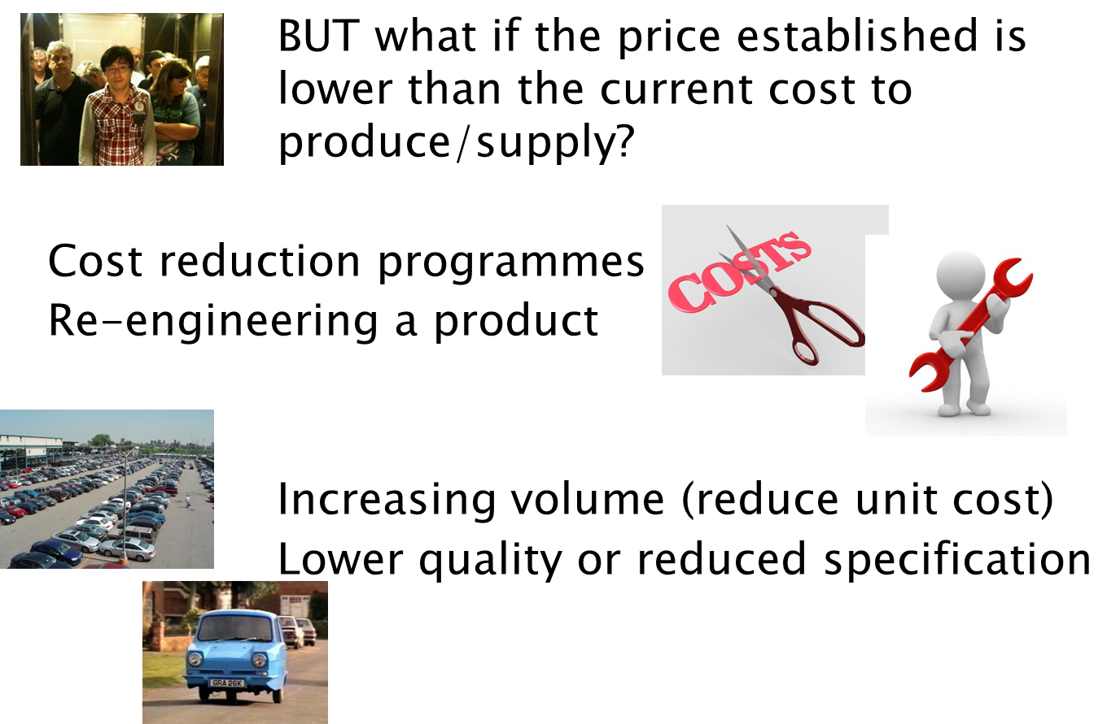
Target costing

Slide 31
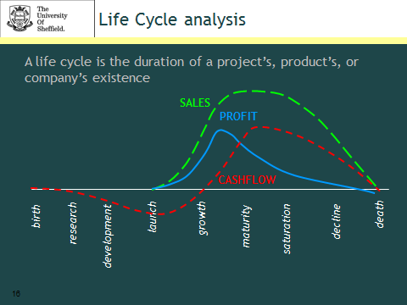

Slide 32
Life Cycle Analysis
For products with a dynamic environment cost plus pricing is not relevant.
Money will have been invested in research and development before a product is launched and these costs as well as costs of production need to be recouped.
Initial production costs per unit will be high, staff training, new methods of manufacture, new processes.
Advertising and marketing costs will also be high.
These unit costs should fall further into life cycle of product.

Slide 33
Life Cycle Analysis
The sales price will initially be high. New product to market, no competition.
If market price is high, competitors will enter the market unless the process or product can be protected.
As more of the product is supplied or similar products are supplied the price will fall.
Eventually the innovation will be overtaken.
Pricing in this type of environment need careful consideration with accurate forecasts of sales and cost over the life of the product.

Slide 34
Reading (optional)
Gowthorpe: Chapter 13

